Slide 1
Final Engagement
Attack, Defense & Analysis of a Vulnerable Network
Russell Gerfen, Peninnah Nikundana, Ryan Anderson, Maddie Cookson, Daniel Payne, Daniel Maher

Slide 2
Table of Contents
This document contains the following resources:
Network Topology & Critical Vulnerabilities
Exploits Used
Methods Used to Avoiding Detect
Notes:
We separated our presentation into 3 sections in order to cover all aspects of the attack, and alternative approaches. We Mapped out our Network and the roles of the Vm’s we used. The Vulnerabilities we found within the Victims machine to establish our attack surface and then the exploits we used against some of the Vulnerabilities and then alternative methods we could’ve used to avoid triggering the alerts we had triggered through the course of this attack

Slide 3

Network Topology
& Critical Vulnerabilities
‹#›

Slide 4
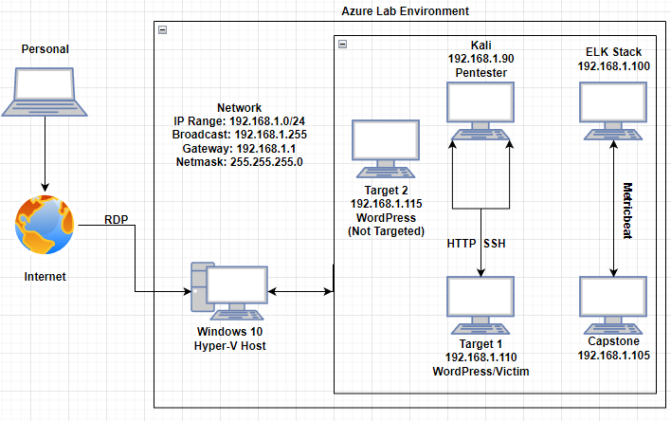
Network Topology
Notes:
This lab was set up through a Remote Desktop connection and the servers were hosted through a hyper-V host manager with 5 Virtual machines. All Vm’s are in the IP range 192.168.1.0/24. Broadcast, and Mask . We used our Kali machine as our attacker machine, Only targeted our target 1 machine user shell through ssh and accessing it through http. Our Capstone logs files from the attack and forwards the activity logs to the kibana ELK stack processed through Metric beat and filebeat. And the ELK stack was accessible through http to view ournewly created logs. cheater…

Slide 5
Critical Vulnerabilities Used: Target 1
Our assessment uncovered the following critical vulnerabilities in Target 1:
Vulnerability | Description | Impact
Enumeration of WordPress | Used WPScan to find a username to access the WordPress web server | Allows attackers to easily find usernames to access the WordPress web server
Weak User Passwords | Found user passwords through the hydra command, guessing, and in the wp-config.php file | Allows attackers to easily guess or brute force user passwords to gain access.
Unsalted Password Hashes | WordPress database lists password hashes that can be easily found and ran against a wordlist to be cracked | Allows attackers to find and crack high privilege account password hashes and sign into the web server and alter the contents
Misconfigured User Privileges / Escalation | Steven has sudo python privileges | After logging on as Steven, we see that he has sudo python privileges and ran a python script to escalate to root

Slide 6
Critical Vulnerabilities Found: Target 1
Our wp-scan uncovered the following critical vulnerabilities in Target 1.
Vulnerability | Description | Impact
XML-RPC pingbacks attack | Attackers are able to leverage the default XML-RPC API. | The vulnerability allows attackers to perform callbacks for DDOS attacks, a Cloudflare Protection Bypass, and Cross Site Port Attack.
WordPress XMLRPC GHOST Vulnerability Scanner | CVE-2015-0235 | Allows attackers to remotely take complete control of the a system without having any prior knowledge of system credentials.
Wordpress XMLRPC DoS - Metasploit | CVE-2014-5266 | A XML denial of service which affects wordpress 3.5 - 3.9.2
Wordpress XML-RPC Username/Password Login | CVE-1999-0502 | Uses XMLRPC in attempts to authenticate against a Wordpress site using username and password combination by the USER_FILE, PASS_FILE, and USERPASS_FILE options.
Wordpress Pingback Locator - Metasploit | CVE-2013-0235 | Will scan for wordpress sites with Pingback API enabled. An attack can cause the wordpress site to port scan an external target and return results.

Slide 7
Exploits Used
‹#›

Slide 8
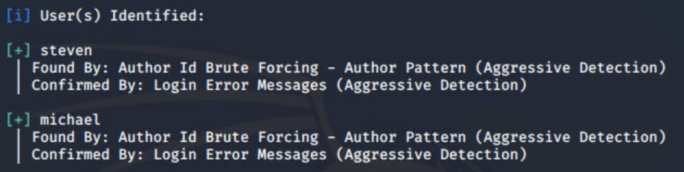
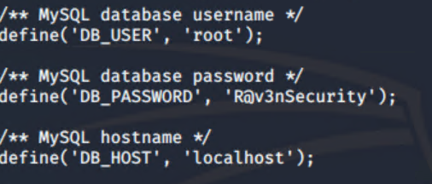
Exploitation: Enumeration of WordPress
Summarize the following:
How did you exploit this vulnerability?
For WordPress usernames
wpscan –url http://192.168.1.110/wordpress –enumerate u
Wordpress password in /var/www/html/wordpress/wp-config.php file
cd /var/www/html/wordpress/ && cat wp-config.php
wpscan results wp-config.php

Slide 9
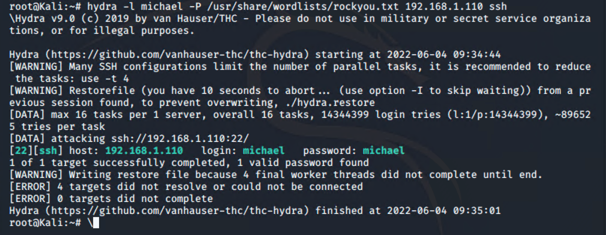
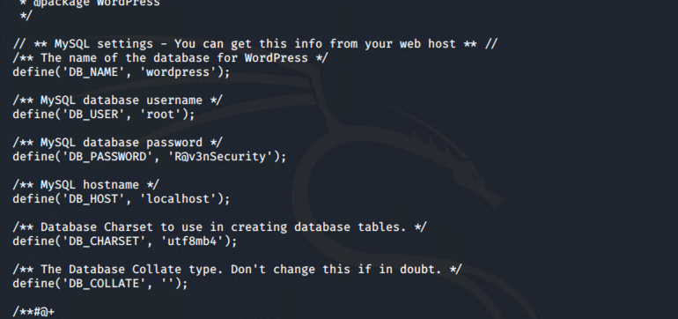
Exploitation: Weak User Passwords
Summary:
Used Hydra to brute force into Michael’s account
This took no more than a minute due to a weak password (his name)
Then with an open ssh port we were able to access a user shell with Michael’s account
Discovered the password for the SQL Database

Slide 10
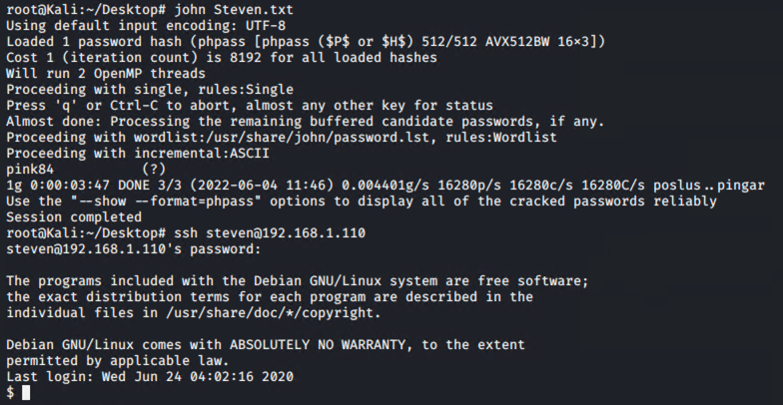
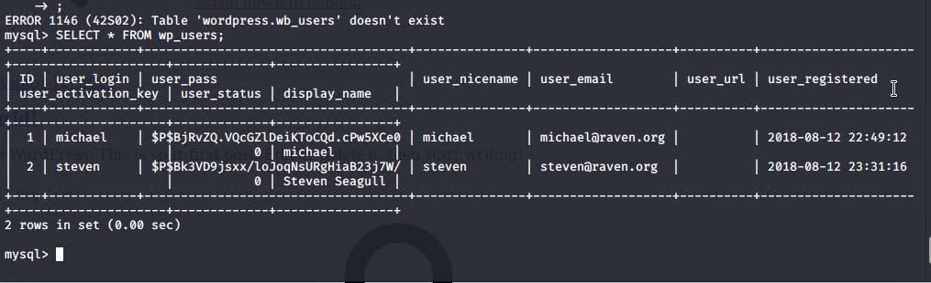
Unsalted Password Hashes
Summary:
From the SQL database navigating to users directory was easy which contained unsalted password hashes
With John the Ripper cracked Steven’s hash and retrieved his password
This gave us escalated privileges on the WP server

Slide 11
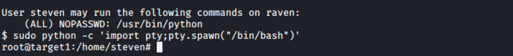
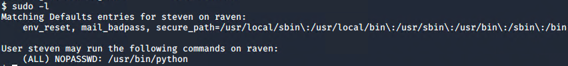
Misconfigured User Privileges (Escalation)
Summarize the following:
With Steven’s account we had privileges to run python scripts as root.
running the command sudo -l allows us to see what paths to run with the subsequent command
sudo python -c ‘import pty;pty.spawn(“/bin/bash”)’
Gives us access to root

Slide 12
Avoiding Detection
‹#›

Slide 13
Stealth Exploitation of Port Scanning
Monitoring Overview
Which alerts detect this exploit?
WHEN sum() OF http.request.bytes OVER all documents IS ABOVE 3500 FOR THE LAST 1 minute
Which metrics do they measure?
http.request.bytes
Which thresholds do they fire at?
3500 kb for the last 1 minute.
Mitigating Detection
How can you execute the same exploit without triggering the alert?
nmap -sC -sV -sS 192.168.1.110
Are there alternative exploits that may perform better?
nmap -sS (stealth scan) is the best way to scan ports without being detected. Other option include netcat and masscan.

Slide 14
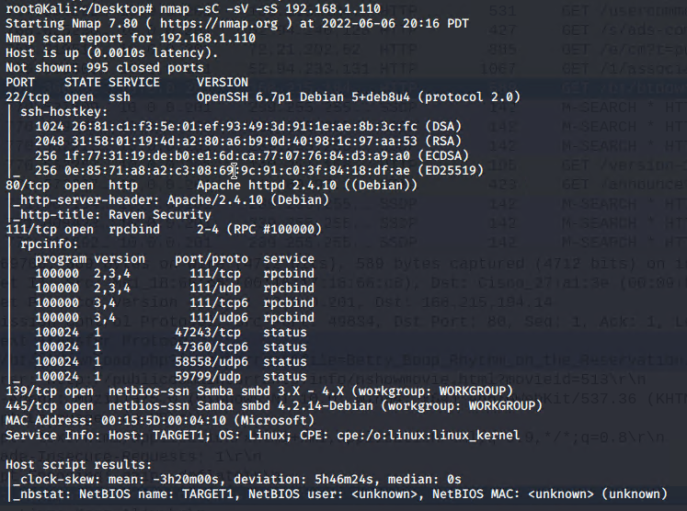
Stealth Exploitation of Port Scanning
Mitigating Detection
If possible, include a screenshot of your stealth technique.

Slide 15
Stealth Exploitation of Enumerating WordPress
Monitoring Overview
Which alerts detect this exploit?
WHEN count() GROUPED OVER top 5 ‘http.request.status_code’ is ABOVE 400 FOR THE LAST 5 minutes
Which metrics do they measure?
http.request.status_code
Which thresholds do they fire at?
Over 400 http responses over a five minute period
Mitigating Detection
How can you execute the same exploit without triggering the alert?
Implement a pause for 1 minute after every 100 http requests
Are there alternative exploits that may perform better?
wp scan is the best performing exploit to use against wordpress

Slide 16
Stealth Exploitation of Weak Passwords
Monitoring Overview
Which alerts detect this exploit?
WHEN max() OF system.process.cpu.total.pct OVER all documents IS ABOVE 0.5 FOR THE LAST 5 minutes
Which metrics do they measure?
system.process.cpu.total.pct
Which thresholds do they fire at?
Above 0.5 per 5 minutes
Mitigating Detection
How can you execute the same exploit without triggering the alert?
-Put michaels and stevens hash into wp-hashes.txt file and use sftp to download it to local machine and use john the ripper offline.
Are there alternative exploits that may perform better?
No, Downloading the hash to local machine and running john the ripper on the local machine (offline) is the best way to brute force weak passwords.

Slide 17
Maintaining Access
‹#›

Slide 18
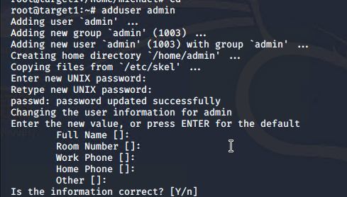
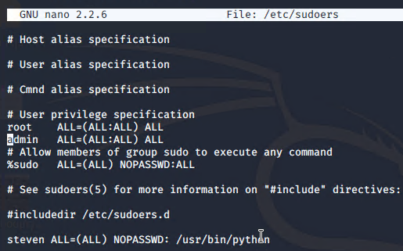
Maintaining Access
Create Backdoor
What type of backdoor did you use?
Created a user “admin” with root privileges
How did you drop the backdoor?
Once we got root access we used adduser command
and added the user to the sudoers file with root privileges.
How did you reconnect to it?
ssh admin@192.168.1.110
> admin
We now have a backdoor with root access.

